Slide 1
The Engine Room
What did you observe? What questions do you still have?

Slide 2
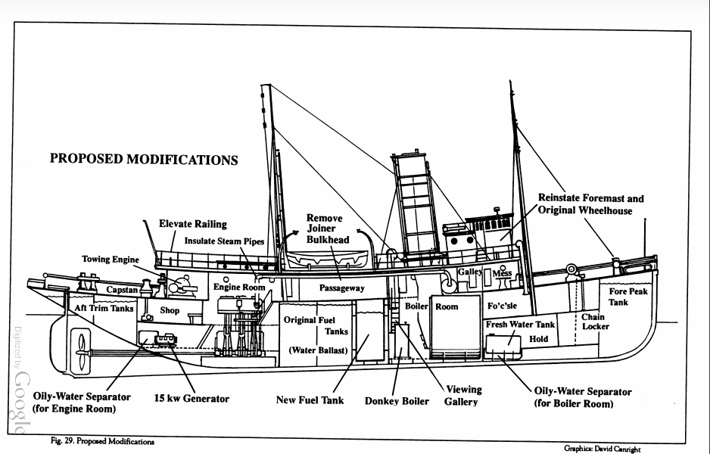
Where is the engine room?
Boiler room
Engine room
Zoom in! How are the boiler room and engine room connected to each other?
Notes:
Note that there is an insulated steam pipe that moves steam from the boiler room to the engine room.

Slide 3
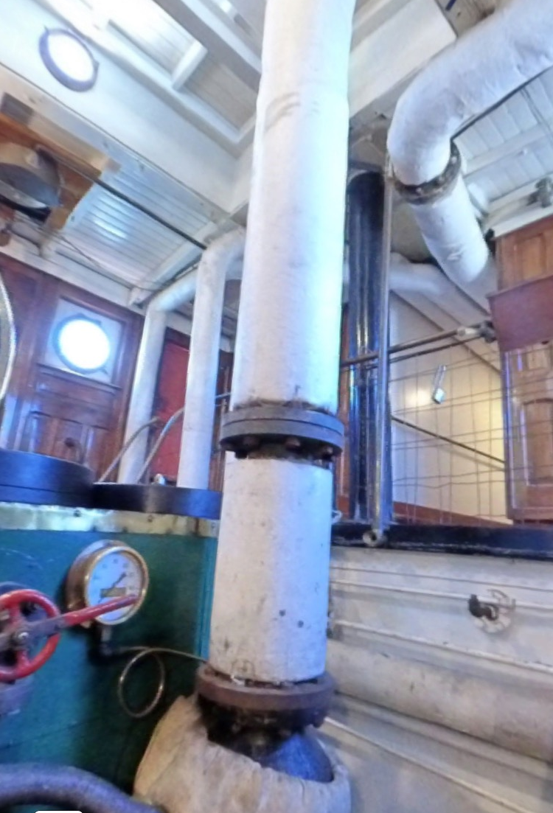
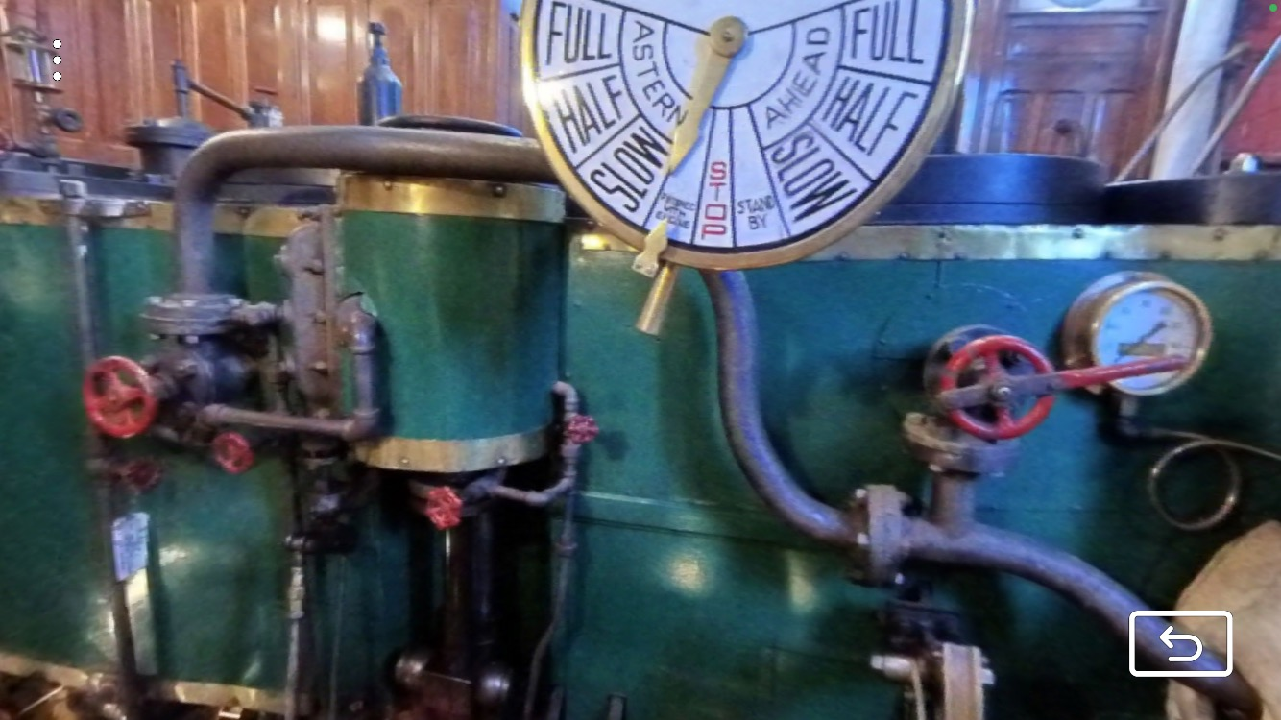
What’s steam got to do with it?
Steam from the boiler room is pushed into the engine room. What happens when the steam builds up? Let’s find out!

Slide 4
Experiment
Observe the balloon closely as your teacher heats up water in the beaker using fire. What do you observe? Write about and draw your observations!
How do you think this experiment connects back to what is happening in the engine room?
Observational Drawing
Accurate Big Colorful Detailed Explained (includes labels)
Notes:
Experiment: Fill the beaker with water and then place a balloon over the neck. Place the beaker system over the fire. Allow students to observe the water being converted to steam. Steam should fill up the balloon so that it inflates. When the balloon is inflated, squeeze the neck so that air is trapped. Place the balloon neck over the mini-engine system. Release the neck and allow students to observe how steam powers the engine. This is connected to the engine room because steam is being used to power the engine.

Slide 5
Class Share
What did you observe?
What do you think is happening?
How does this relate back to Hercules’ boiler room & engine room?

Slide 6
Pressure
Pressure is a force on an object.
  We apply pressure on a door when we want to open it.
  We apply pressure on a pencil when we write.
  What are some other ways we see pressure in our everyday lives?
Let’s observe how molecules apply pressure to move objects!
  What do you observe? Write about and draw your observations!
How can we apply what we observed?
  What role does pressure have in making the balloon bigger?
  What role does pressure have in moving the engine?
Notes:
Modification: Students could use the simulation in partners/independently & share with the class.
Molecules push against the balloon to increase pressure and increase the overall size. Molecules in the steam create pressure to push parts of the engine down so that it is powered.

Slide 7
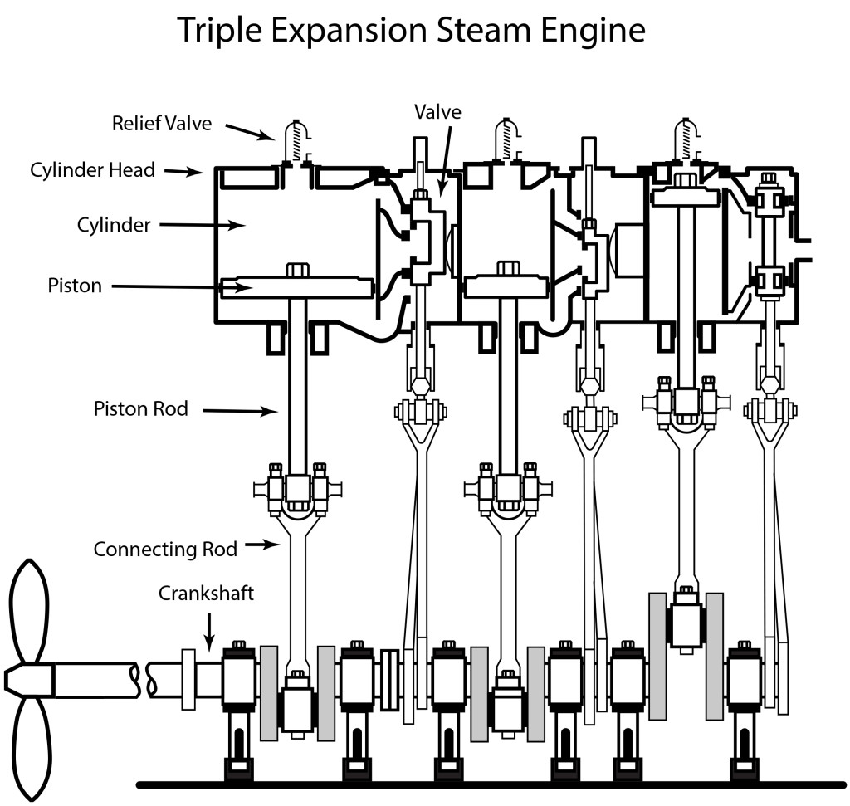
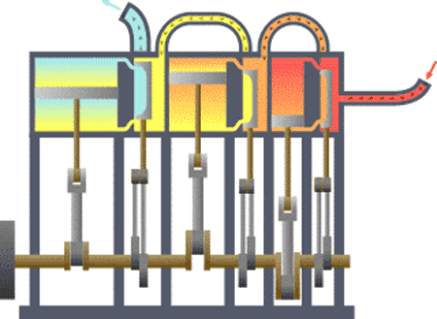
What’s going on in the engine room?

Slide 8
How does steam move from cylinder to cylinder?
cylinder
Notes:
Steam moves from cylinder to cylinder using the orange, yellow, and blue tubes shown in the gif.

Slide 9
How do valves control how steam enters a cylinder?
valve
Notes:
When the valves are pushed down, they allow steam to enter the cylinder.

Slide 10
How do steam and pressure move the piston?
Hint: look at how little room the steam has when it first enters the cylinder!
Notes:
There is very little room in the cylinder for the steam. As the steam molecules enter the small space, they create a high pressure, which pushes the pistons down.

Slide 11
How does the steamboat move when the pistons are pushed down?
Hint: The engine is connected to the boat’s propeller. What does a propeller do?
Notes:
When the piston is moved down, the crankshaft turns. This also turns the propeller. The propeller spins in the water, causing the steamboat to move.

Slide 12
Compare & Contrast
What are some differences between the Hercules’ engine room and our balloon experiment? What are some similarities?
Hercules’ Engine Room
Balloon Experiment
Both
Notes:
Examples: Balloon experiment only includes one cylinder, while Hercules’ engine room had three, Hercules’ Engine Room powered a propellor, while the balloon experiment does not, etc.

Slide 13
Your Turn!
What’s going on in the engine? Follow the directions to show how steam travels through the engine. As you complete the worksheet, think: How does pressure play a role in moving the engine?
Now, think about the cause and effect relationships within the engine. Use the graphic organizer to show how parts of the engine rely on each other to do work.
Before we start, let’s review the idea of cause and effect!

Slide 14
Cause & Effect
Cause: The reason WHY something happened.
  It rained outside.
  Fire heats up the water.
  Your example!
  Your example!
  Your example!
Effect: What happened.
  I wore my raincoat.
  Water converts to steam.
  Your example!
  Your example!
  Your example!

Slide 15
Energy
Energy is all around us! Energy can be stored in things. It can also be used to make things change and move.
We has energy stored in our food. We use that energy when we run and play!
Here are some types of energy:
  Chemical energy: energy that is stored in chemicals and is involved in reactions.
  Heat (thermal) energy: energy in the form of heat.
  Mechanical (motion) energy: energy in the form of movement.
When do you see these forms of energy in your everyday life? Can you think of other types of energy you see?

Slide 16
Energy Transfer
Energy comes in all forms! Some examples are heat energy, electrical energy, sound energy, and light energy.
Energy can be transferred, or converted, from one form to another.
  When we eat food and then move around, we transfer chemical (stored) stored in food to mechanical (movement) energy.
  When we use a toaster oven, we transfer electrical energy from the wires in the wall to heat energy to toast our bread.
Can you think of another time in your everyday life where you see an energy transfer?

Slide 17
Exit Ticket
What is the transfer of energy in the engine room? Use the word bank to help you label the different types of energies as they pass through the systems.
Try your best! We will review this information tomorrow.
Word Bank
Heat energy Mechanical (movement) energy Chemical Energy
Notes:
See Exit Ticket Answer Key

